Slide 1


Notes:
You can change the picture if you’d like.

Slide 2
Welcome to Pack 123!
Intros
(insert picture of pack doing something fun!)
Notes:
UPDATE FOR YOUR PACK: Unit Number, Intro’s etc. (see items in yellow)
Introduce self and welcome everyone to the meeting

Slide 3

What is Cub Scouts?
Cub Scouting is fun!
Families spend time together!
Program for all youth in grades K-5
Do things and go places!
Earn awards!
Do activities and go to camp!
Year round program!
Notes:
Explain what Cub Scouts is all about. Make sure to be enthusiastic!

Slide 4


Things we do:
Fishing
Skating Party
4th of July parade
Rocket launch
Bike rodeo
Pinewood derby
Day Camp!
Notes:
UPDATE FOR YOUR PACK: Insert activities & picture specific to your Pack.
Tell the families what they will do with your pack, be specific.
Share Printed Copies of your Pack Calendar

Slide 5

Scouting’s Youth Magazine
Official magazine of the BSA
Scout’s Life is $15 a year and delivered to your child
Notes:
Explain Boy’s life magazine

Slide 6
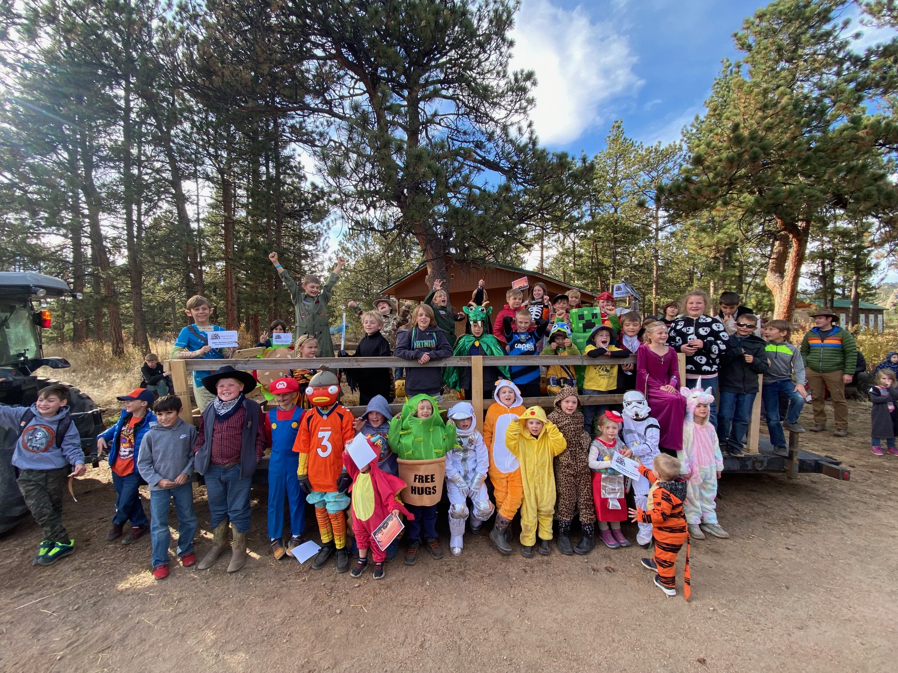
Cub Haunted!
1st Overnight Campout! A Spooktacular event!
October XX-XX at Camp Jack Nicol
Cost: $45-$65
Notes:
UPDATE with the date your pack is attending Cub Haunted

Slide 7
Cub Activity Time!
Notes:
All new and current Cub Scouts are taken to another location to work on the Bobcat Badge or do an activity.
You’ll need at least 2 adults to run this.
Tell the parents what will happen with their kids, Introduce the Adult Leaders and explain what the youth will be working on.
This will give parents the opportunity to focus their attention on the details.

Slide 8
Pack 123 - Organization
The Pack is all of the youth (grades K-5) and their adult leaders
The Pack meets once a month for a fun meeting (Pack meeting)
Notes:
Explain how the pack is organized, when they meet and how the Dens work.

Slide 9

Dens
The Pack is divided into “Dens” by grade, Dens meet 1-2 times a month.
  Lions (Kindergarten)
  Tiger (1st grade)
  Wolf (2nd grade)
  Bear (3rd grade)
  Webelos (4th grade)
  Arrow of Lights (5th grade)
All Scout Activities are age-appropriate

Slide 10
Volunteers
Parents make Scouting go!
Cub Scouts is designed to help parents spend time with their child
Parents participate with their child
Parents are the major source of pack leadership (plan events, run den meetings)
Notes:
Explain how Cub Scouts is designed to give parents and opportunity to spend time with their kids.
Parents make up the volunteers who make the pack go.

Slide 11
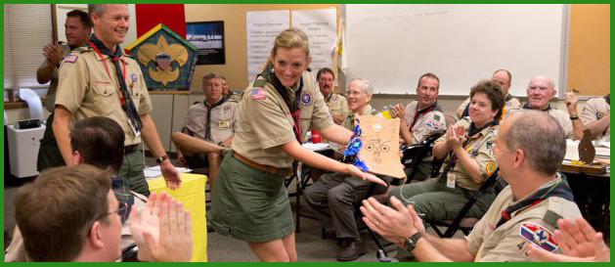
Training for Volunteers
Online & In-Person Training is offered to ensure a quality program and to keep our youth safe
Every Scout deserves a trained leader
Notes:
Tell them how training is provided to help all volunteers be successful!

Slide 12

We are Pack 123!
We are chartered by:
We are part of the District
  of the Adventure West Council
  www.awbsa.org
Notes:
Update Chartered Organization and District
Explain who the pack is chartered by, the district you belong to and a little about our Council.

Slide 13
Pack Meeting
Our Pack meetings are held on:
Our next Pack meeting is:
Location:
Time:
Notes:
VERY IMPORTANT! – Update with your pack’s information.
Explain when your next Pack meeting is and make sure everyone leaves with the information.

Slide 14
Pack Leadership
Cub Master contact info:
Committee Chair contact info:
Notes:
IMPORTANT: Update with your pack information.

Slide 15

How the Pack funds itself
Pack dues (if any)
Annual fundraisers
  Popcorn Sales
  Spring Product Sales
Notes:
UPDATE: Tell the parents how much Scouting in your Pack will costs and what fundraisers you do to offset the costs.
Pack’s with a strong program and funding plan attract and keep families

Slide 16
Annual Registration Fees
$14 a month, paid annually ($168)
  Includes the National Membership Fee & Council Program Fee.
  Includes Local Council Insurance fees, Accident Insurance, Participant Health Insurance, and Property Insurance.
  Includes the Scout Handbook for any new Scout when they join Scouting for the first time ($25 Value).
Scout’s Life Magazine is $15
Pack Dues are $ (if any, or delete)
There will be additional costs for campouts, uniforms etc.
Notes:
Let them know that they are registering for 12 months.

Slide 17
Den Breakouts
Take 10 Minutes to
Ensure all Dens have full leadership!
Notes:
Utilize the Magic Circle Technique to recruit and fill vacancies, such as den leaders, committee members etc.
Magic Circle instructions found at www.awbsa.org/membership

Slide 18
Scout Presentation!
Notes:
Have youth show their parents what they’ve learned - recite Cub Scouts Promise and Sign

Slide 19

Questions?

