Slide 1
Membership Bootcamp
Training for Unit leaders
Notes:
Welcome & Introductions

Slide 2
WHY ARE WE HERE?
Because SCOUTING IS A MOVEMENT!
Vision Statement:
The Boy Scouts of America will prepare every eligible youth in America to become a responsible, participating citizen and leader who is guided by the Scout Oath and Law.
Notes:
Why are we here tonight at the Cub Scout Recruitment Training?
You are part of the MOVEMENT! We exist to GROW! We exist to impact the lives of more young people!
Each Pack has a responsibility to ensure all families are invited to be a part of Scouting.

Slide 3
Full Family Fall Recruitment
PURPOSE & OBJECTIVE
Ensure every family is invited to sign-up
Ensure all schools have a sign-up night
Ensure new families feel welcome
To recruit new adult leadership
To start new Scouting units
Increase community awareness
Notes:
What is the Purpose of Full Family Fall Recruitment?

Slide 4
Full Family Fall Recruitment
KEY POINTS TO THE PLAN
1st - It’s about recruiting parents!
2nd - It’s about Coordination
  We are 34 Counties in 3 States with 3,000+ Scouts
3rd – It’s about using best practices
4th – It’s about simplifying things
Notes:
1st -
- There are a lot of ways to recruit Scouts, but our program is unique, it requires the parents be actively involved and that means that we MUST recruit the parents on the very 1st night.
- We run a very specific plan in the fall, not to recruit youth but to recruit their parents.
2nd – We have limited resources, to make sure every pack has the resources they need to be successful requires a coordinated effort. If we all follow the plan, everyone can have success.
3rd – Our plan is build on best practices that have a proven record of producing results. These are based on both research and experience.
- One example is having a sign-up night at every elementary school. Parents are SIGNIFICANTLY more likely to sign-up if the sign-up night is at the school they already are comfortable with.
4th – It’s about simplifying things for both Unit leaders and parents.
- Scouting can be complicated, especially for new families. The goal is to make Scouting easy for them to understand and enjoyable.
- New Parents want to know the answer to 2 questions:
- What are we going to do?
- And How much is it going to cost?
- This plan helps Pack leaders answer those 2 questions.

Slide 5
Full Family Fall Recruitment
OVERVIEW
5 Steps to a Successful Fall Recruitment
Notes:
Read Overview on 5 Steps Doc.
Designed for today’s busy parents, a Sign-up Night is held at each elementary school the pack recruits from.
Families walk in, sign-up and are invited to attend the pack’s orientation meeting held about a week later.
Families should be in-and-out in less than 10 minutes. At the pack’s orientation meeting the youth will
receive their Handbook and Rocket for rocket academy. Parents will learn the Packs annual activity/funding
plan and vacancies in pack leadership are filled.

Slide 6
5 STEPS to a Successful Fall Recruitment
Step 1: Pack Organizes a Volunteer Team
Step 2: Pack Heavily Promotes & does Scout Talks
Step 3: Pack Holds a Sign-up Night at each individual Elementary School
Step 4: Pack Turns-in Paperwork & Receives Handbooks
Step 5: Pack Holds a Parent Orientation Meeting
Notes:
Quickly Review the 5 steps to a Successful Fall Recruitment.
Each of these will be discussed in detail.

Slide 7
STEP 3: Hold Sign-up Night(s)
A Sign-up night is held at each elementary school.
Welcome Families
  Provide Pack QR code or Youth App
  Provide the AWC New Parent Guidebook
  Provide the Pack Information Flyer (created in advance)
Answer Questions & Help the sign-up
  If family doesn’t join, collect contact information & invite to Parent Orientation mtg.
Notes:
We are actually going to start on STEP 3.
Big Change for some units is moving to a sign-up night being held at each Elementary School.
In the past this was an hour-long meeting that was very time-intensive and as a result Pack leaders were very reluctant to hold an event at each School.
Pack recruits form 3 schools, they hold 3 separate sign-up nights. 1 at each school. They can be on the same night. The key is that they are at the school or in the School parking lot.
New Sign-Up Night Plan:
Keep It simple. Don’t over complicate this.
Objective is to Sign the Scout’s up.
Provide the Pack, QR code or Youth App / Scout’s Life Mini-Mag / AWC New Parent Guidebook
Provide the Pack Information Flyer
This MUST be created in advance by Pack Leadership
Examples will be available on the website.
Our Council is willing to print these for the units.

Slide 8
STEP 3: Hold Sign-up Night(s)
Keep these simple.
Keep it short. (families are there to sign-up)
Keep it AT THE SCHOOL! (best practice)
  Can be done in the parking lot!
Push online registration via Pack QR code.
Use the Fire-Tek Rocket Activity!
Notes:
Keep the Sign-up Night Simple. You only need 1 volunteer for this, it’s just to answer questions, collect money and sign them up.

Slide 9
BEST PRACTICE!
It’s VITAL that individual Sign-up Nights are held at each Elementary School
Parents are SIGNIFICANTLY more likely to attend and sign-up if held at their Child’s School.
Market research from 2018-2019 found that:
- Neighboring Schools showed limited success
- Church’s DID NOT work AT ALL!
Notes:
Of all the best practices, this is probably one of the most important, along with Scout Talks or Talking to the youth. Every school needs to have their own sign up night. This means that if a pack recruits from multiple schools, they need to have multiple sign-up nights. Sign-up night’s can be at the same time, they just need to be help at each school.
Market research performed over the last 2 years from the National Organization found that
Inviting families to a neighboring school to sign-up did not work well and had limited success (Less than 1 youth from a neighboring school on average)
Inviting families to a local church to sign-up DID NOT work AT ALL! The results nationwide were almost zero.
We don’t know the exact reasoning for this, but we have some ideas such as:
“that pack must be just for kids of that faith”
“I’m uncomfortable walking into a church that is not my own”
“we’re not really a religious family, so we’ll just put our kids in something else”

Slide 10
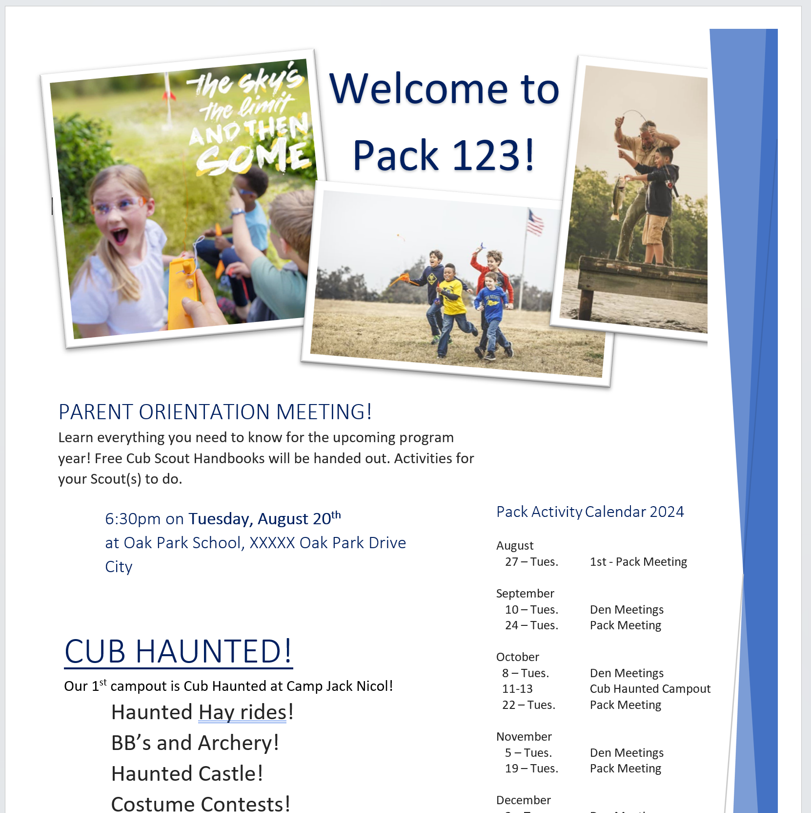
Notes:
Prior to your Sign-up Night, you need create a pack information flyer. This is an example pack flyer. This is available on the website for easy updating.
Tell families what your Pack does!
Share part of your program Calendar
Provide contact info
Use Pictures
Put some time and energy into your Pack’s information flyer. Make is look fun and exciting with lots of good info.
Pack Information Flyer (created in advance) which includes:
Date, time, & location of the Parent Orientation Meeting
Pack’s basic information: Chartered Org / Pack meeting dates / Key contact information
Pack’s Program Calendar with pictures
How the Pack funds itself (popcorn, camp-cards)

Slide 11
STEP 4: Turn in Paperwork
Use & Fill out the Reporting Form
  Include youth that joined online (we prefer online)
Turn in paperwork and fees
Pick-up your Free Cub Scout Handbooks!
Do this Prior to Parent Orientation Meeting
Notes:
Use the Reporting Envelope – 1 For Each SCHOOL!
Turn this into your DE or Scout Office or Facilitator (If they have Books)
Make sure to complete this prior to the Parent Orientation Meeting, so that you can hand them out that night.

Slide 12
STEP 1: Organize Volunteer Team
Unit New Member Coordinator
Sign-up Night Promoters
Sign-up Night Volunteers
Parent Orientation Meeting Den Organizers
Parent Orientation Meeting Activity Leaders
Notes:
Now we are going to jump back to STEP 1.
The District Facilitator will work with your Pack’s New Member Coordinator to help.
In addition to the Unit New Member Coordinator, the Pack will need volunteers. These volunteers help promote the sign-up nights, attend the sign-up nights and sign up families, and help at the Parent Orientation meeting.
Depending on the size of your pack you’ll need more or less volunteers.
Pack’s should have multiple Sign-up Night Promoter Volunteers as this is one of the most important parts of the plan.

Slide 13
STEP 2: Promotion & Scout Talks
Posters ( 2 per School)
Flyers ( 2 rounds)
Stickers (With Scout Talks)
Yard Signs ( 2 per School)
Notes:
Promotion! Promotion! Promotion! – VERY IMPORTANT to your Pack’s success. Most Sign-up nights that aren’t successful can be directly traced to lack of promotion.
Use the Flyer Order Form to get all of your items.
Encourage the packs to spend $14 on a facebook ads per school. Create the event with their pack’s facebook page/group and “boost” the add. $1 a day for 14 days is all that’s needed.

Slide 14
STEP 2: Promotion & Scout Talks
Open Houses / Back to School Nights
School Announcements
Kindergarten Roundups
Sidewalk Chalk
Peer to Peer Cards
Call Parents from PTA / PTO List
Uniform or t-shirt day
Notes:
Other Ideas on Promotion. More listed on 5 Steps to a Successful Fall Recruitment Doc.
Ask the audience for other ideas of what they have done?

Slide 15
STEP 2: Scout Talks
Most effective Scout promotion
    Room to room & Assembly = best results
    Lunch room = good results
    During Recess / Bus Stop = Ok results
    USE ANY WAY POSSIBLE TO TALK TO THE YOUTH!
Rule #1 – Exude Excitement!!!
Notes:
Scout Talks are easily the best way to get families involved in Scouting.
The Key is to TALK to the youth and it really doesn’t matter how you do it, just THAT you do it.
The District Membership Committee & District Executive will help with these.

Slide 16
HOW TO DO A SCOUT TALK
Hey everyone, I’m __________ with Pack ___ and I’m hear to invite all of you to become a Cub Scout! We’re going to play a little game to help teach you what activities Cub Scouts do! This game requires no talking.
Everyone ready? Raise your hand if you like to _______. Ok Put your hands down. Raise your hand if you like to….. (Go swimming, go camping, shoot bb-guns, shoot bows and arrows, rock climb, go fishing, etc.) Do 4-5 of them
Those are all thing that we do in Cub Scouts! Everyone can join Cub Scouts! Boys & Girls! We want each of you to become a Cub Scouts!
So, tonight at 7:00pm, right here in your school cafeteria you can sign up to be a Cub Scout! And I’m going to give each of you a sticker that has all the information on it. Once again it’s tonight at 7:00pm, right here in your school cafeteria. So when you get home, show your parents this sticker and say I want to be a Cub Scouts!
Thanks everyone, see you tonight!
Notes:
This example Scout Talk came from an Elementary School Principal. Sometimes a Scout Talk can get the kids over excited which makes it difficult for the teachers who have to get the kids calmed back down.
This Scout Talk get’s the kids excited while keeping the room from turning into a rock concert.
Principals appreciate when we use this Scout Talk and it is very effective.
With the Scout Talk – Hand out our Custom Printed Stickers which you can order when you submit your flyer order form.

Slide 17
STEP 5: Hold Parent Orientation Mtg
Re-invite all families via E-mail & Phone call
Set-up the Room: 1 Den per table with Table-Tents
Update the Parent Presentation PowerPoint prior to meeting.
  Add Pictures of your Pack / Tell them what your Pack does!
  Found at www.awbsa.org/membership-growth
  You don’t need to show this, it can be used as a script
Notes:
Now we jump back to STEP 5: Hold the Parent Orientation Meeting.
For review:
1- You’ve put together your team,
2 - you’ve promoted the Sign-up Nights,
3 - You’ve held a Sing-up Night at each Elementary School,
4 - You’ve turned in your paperwork and received your rockets
5 – NOW You hold your Parent Orientation meeting to RECRUIT the parents!
Re-invite Families / Set up the room / UPDATE the parent Powerpoint for your unit

Slide 18
STEP 5: Hold Parent Orientation Mtg
Have Greeters meet families as they arrive
Conduct an Opening Ceremony
  Start on time
  Introduce Pack Leadership
  Conduct Flag Ceremony
Use the Unit Presentation to Parents PowerPoint
  Again, Doesn’t need to be shown & can be read/ used as a guide/script
  A PDF version is available on website
Notes:
Biggest point on this is that the Powerpoint Doesn’t need to be shown, it can be read or used as a guide.
A PDF version is available on the website with fill in the blank sections.

Slide 19
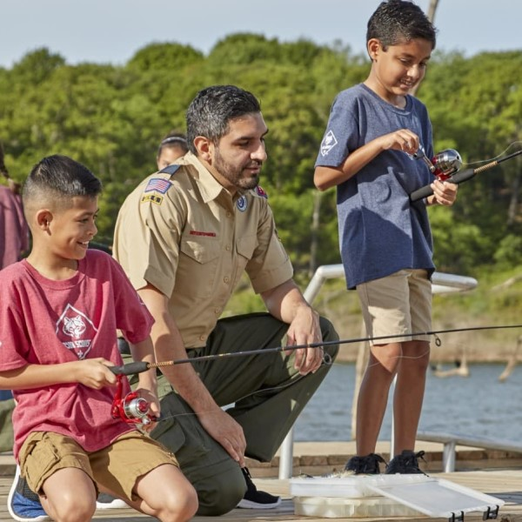

Notes:
You can change the picture if you’d like.

Slide 20
Welcome to Pack 123!
Intros
(insert picture of pack doing something fun!)
Notes:
UPDATE FOR YOUR PACK: Unit Number, Intro’s etc. (see items in yellow)
Introduce self and welcome everyone to the meeting

Slide 21

What is Cub Scouts?
Cub Scouting is fun!
Families spend time together!
Program for all youth in grades K-5
Do things and go places!
Earn awards!
Do activities and go to camp!
Year round program!
Notes:
Explain what Cub Scouts is all about. Make sure to be enthusiastic!

Slide 22


Things we do:
Fishing
Skating Party
4th of July parade
Rocket launch
Bike rodeo
Pinewood derby
Day Camp!
Notes:
UPDATE FOR YOUR PACK: Insert activities & picture specific to your Pack.
Tell the families what they will do with your pack, be specific.
Share Printed Copies of your Pack Calendar

Slide 23

Scouting’s Youth Magazine
Official magazine of the BSA
Scout’s Life is $15 a year and delivered to your child
Notes:
Explain Boy’s life magazine

Slide 24
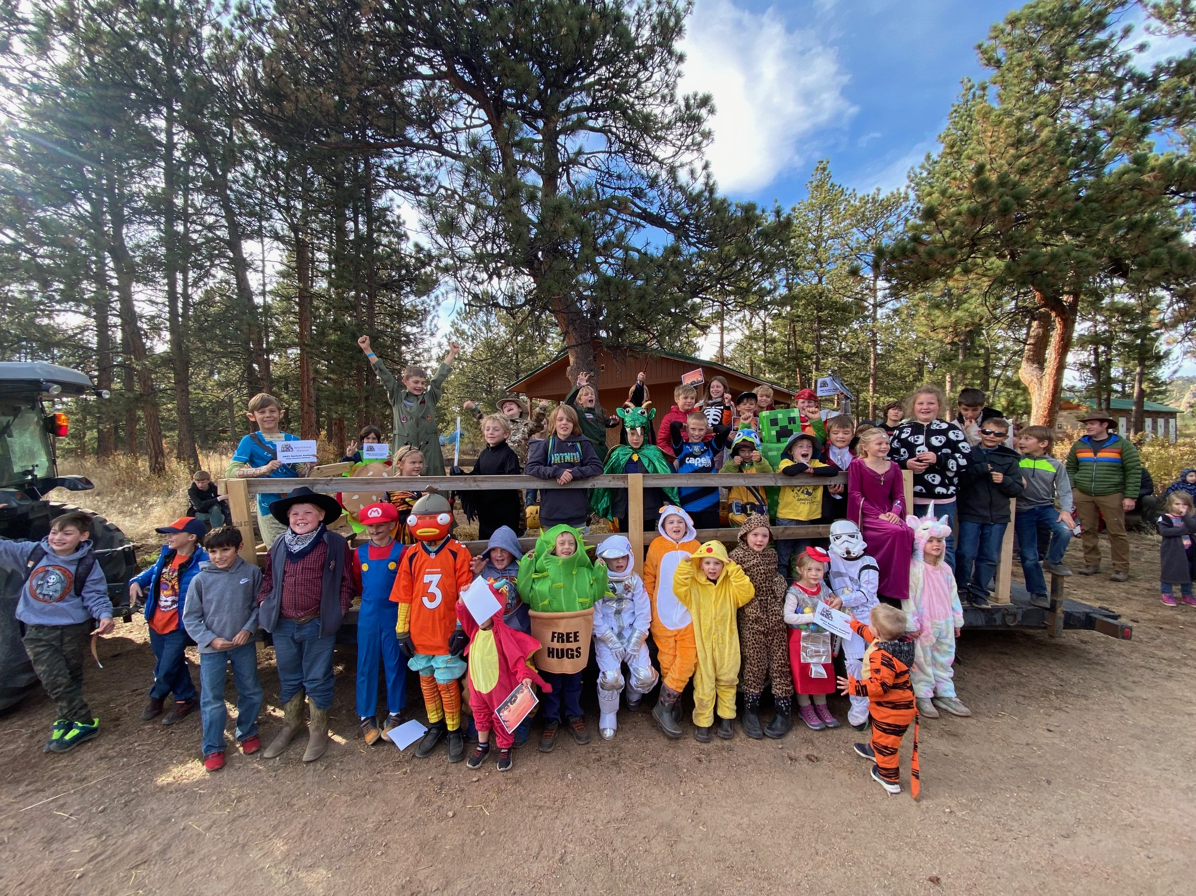
Cub Haunted!
1st Overnight Campout! A Spooktacular event!
October XX-XX at Camp Jack Nicol
Cost: $45-65
Notes:
UPDATE with your local Fishing Derby information

Slide 25
Cub Activity Time!
Notes:
- All new and current Cub Scouts are taken to another location to work on the Bobcat Badge or do an activity.
- You’ll need at least 2 adults to run this.
- Tell the parents what will happen with their kids, Introduce the Adult Leaders and explain what the youth will be working on.
- This will give parents the opportunity to focus their attention on the details.

Slide 26
Pack 123 - Organization
The Pack is all of the youth (grades K-5) and their adult leaders
The Pack meets once a month for a fun meeting (Pack meeting)
Notes:
Explain how the pack is organized, when they meet and how the Dens work.

Slide 27

Dens
The Pack is divided into “Dens” by grade, Dens meet 2-3 times a month.
  Lions (Kindergarten)
  Tiger (1st grade)
  Wolf (2nd grade)
  Bear (3rd grade)
  Webelos (4th grade)
  Arrow of Lights (5th grade)
All Scout Activities are age-appropriate

Slide 28
Volunteers
Parents make Scouting go!
Cub Scouts is designed to help parents spend time with their child
Parents participate with their child
Parents are the major source of pack leadership (plan events, run den meetings)
Notes:
Explain how Cub Scouts is designed to give parents and opportunity to spend time with their kids.
Parents make up the volunteers who make the pack go.

Slide 29
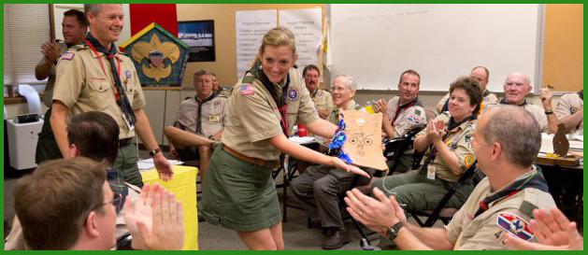
Training for Volunteers
Online & In-Person Training is offered to ensure a quality program and to keep our youth safe
Every Scout deserves a trained leader
Notes:
Tell them how training is provided to help all volunteers be successful!

Slide 30

We are Pack 123!
We are chartered by:
We are part of the District
  of the Adventure West Council
  www.awbsa.org
Notes:
Update Chartered Organization and District
Explain who the pack is chartered by, the district you belong to and a little about our Council.

Slide 31
Pack Meeting
Our Pack meetings are held on:
Our next Pack meeting is:
Location:
Time:
Notes:
VERY IMPORTANT! – Update with your pack’s information.
Explain when your next Pack meeting is and make sure everyone leaves with the information.

Slide 32
Pack Leadership
Cub Master contact info:
Committee Chair contact info:
Notes:
IMPORTANT: Update with your pack information.

Slide 33

How the Pack funds itself
Pack dues (if any)
Annual fundraisers
  Popcorn Sales
  Spring Product Sales
Notes:
UPDATE: Tell the parents how much Scouting in your Pack will costs and what fundraisers you do to offset the costs.
Pack’s with a strong program and funding plan attract and keep families

Slide 34
Annual Registration Fees
$14 a month, paid annually ($168)
  Includes the National Membership Fee & Council Program Fee.
  Includes Local Council Insurance fees, Accident Insurance, Participant Health Insurance, and Property Insurance.
  Includes the Scout Handbook for any new Scout when they join Scouting for the first time ($25 Value).
Scout’s Life Magazine is $15
Pack Dues are $ (if any, or delete)
There will be additional costs for campouts, uniforms etc.
Notes:
UPDATE: Review the registration fee’s, Boy’s Life Magazine Fee, Pack Due’s if any.
Let them know that they are registering for 12 months.

Slide 35
Den Breakouts
Take 10 Minutes to
Ensure all Dens have full leadership!
Notes:
Utilize the Magic Circle Technique to recruit and fill vacancies, such as den leaders, committee members etc.

Slide 36
Why the Magic Circle?
The Magic Circle is a simple way to recruit new parents & it works like MAGIC!
It creates an environment where the parents speak to each other
  They become comfortable with each other
  They share contact information
  They begin to make friendships
This is VERY important because:
  At their next Den Meeting,
  they will be the only people there!
Notes:
See Page 15 of Cub Scout Recruitment Playbook.
District Facilitators should practice this and help support the units with the Magic Circle.

Slide 37
How the Magic Circle Works
Be sure that the group is divided into Dens via Table Tents:
  Lion, Tiger, Wolf, Bear, Webelos, Arrow of Light
Ask for a scribe:
  Ask him/her to write down the vacant positions needing filled
  List a position for all the adults at the table (nobody gets left out)
  Positions can be:
    Den Leader, Assistant Den Leader, Pack Committee Member, etc.
  Inform the group that they must decide who will do each job.
Walk to the next table / Step away:
  Just say “We’ll let you talk amongst yourselves and will be back in a second.”
  You and the other people helping must leave the room or area at this time.
  Stay away at long enough for them to make a decision
Upon returning
  Provide adult applications for the new leaders
  If they haven’t made a decision or have questions. Answer their questions as simply as possible and then move on to the next table.
  Keep encouraging the parents to make a decision until you have a complete team.
  Don’t stand around the Den!
Notes:
See Page 15 of Cub Scout Recruitment Playbook.
District Facilitators should practice this and help support the units with the Magic Circle.

Slide 38
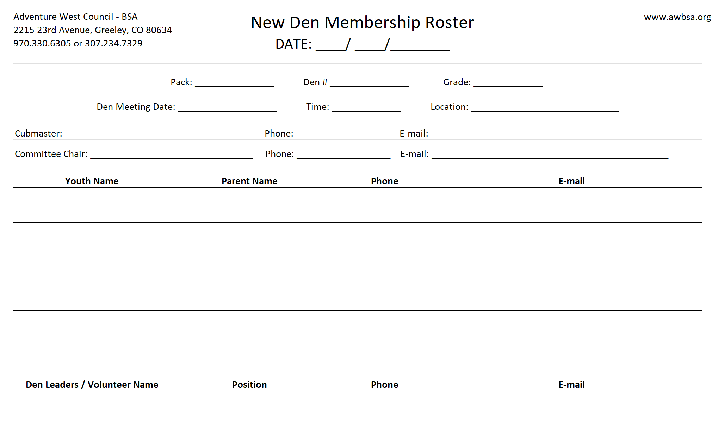
New Den Membership Rosters
Notes:
This 2 page carbon copy document is provide to help our new dens get started quickly.
Each Unit should receive 12 of them and fill one out for each den.
This immediately gives the new Den Leader and Cubmaster the contact information of the new youth that have joined.
Which will help them engage with the families and invite them to the next den meetings / pack meetings.

Slide 39
Scout Presentation!
Notes:
Have youth show their parents what they’ve learned - recite Cub Scouts Promise and Sign

Slide 40

Questions?
Notes:
This is the last slide of the Parent Orientation Meeting.

Slide 41
5 STEPS to a Successful Fall Recruitment
Step 1: Pack Organizes a Volunteer Team
Step 2: Pack Heavily Promotes & does Scout Talks
Step 3: Pack Holds a Sign-up Night at each individual Elementary School
Step 4: Pack Turns-in Paperwork & Receives Handbooks
Step 5: Pack Holds a Parent Orientation Meeting
Notes:
Re-Review the 5 steps to a Successful Fall Recruitment.
This is the plan and we are here to help you achieve success!

Slide 42

How many lives will be changed because of you?
Notes:
Leave them with this: How many lives will be impacted because of you?
Thank them and answer questions.

